Slide 1





Multidimensional Scaling Presentation English Premier League Clubs
By Misheck Malangano

Slide 2
Original Data
Arsenal | Chelsea | Manchester United | Luton Town | Liverpool | Manchester City | Newcastle | Westham | Fulham | Brentford
0
1 | 0
2 | 3 | 0
8 | 8 | 8 | 0
2 | 1 | 2 | 10 | 0
2 | 1 | 1 | 10 | 1 | 0
8 | 8 | 8 | 3 | 8 | 9 | 0
9 | 8 | 8 | 3 | 8 | 8 | 1 | 0
10 | 9 | 10 | 1 | 9 | 10 | 3 | 1 | 0
10 | 10 | 10 | 1 | 10 | 10 | 4 | 2 | 1 | 0

Slide 3
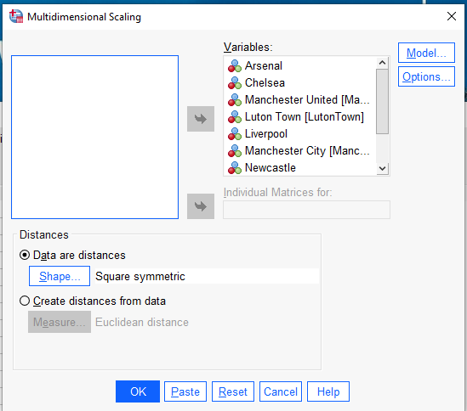
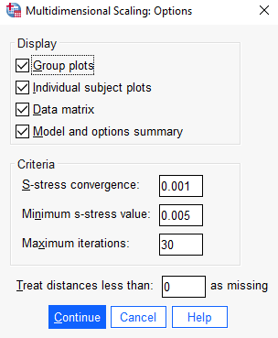
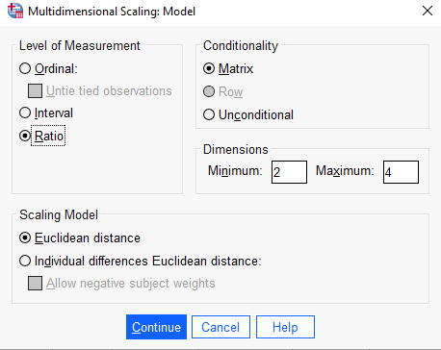
SELECTIONS

Slide 4
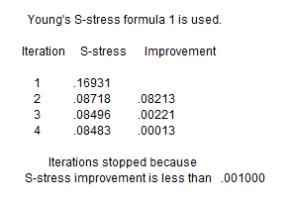
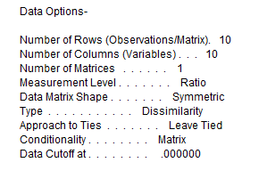
NUMBER OF DIMENSIONS | STRESS | R-SQUARED VALUE
4 | 0.10765 | 0.97911
3 | 0.10543 | 0.97086
2 | 0.12760 | 0.94438
As the Dimensions Decreases The Stress Increases because we are trying to explain the Complexity in fewer Dimensions

Slide 5
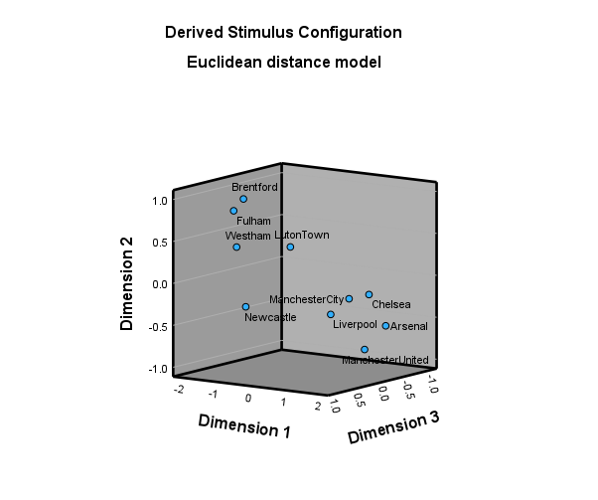

Slide 6
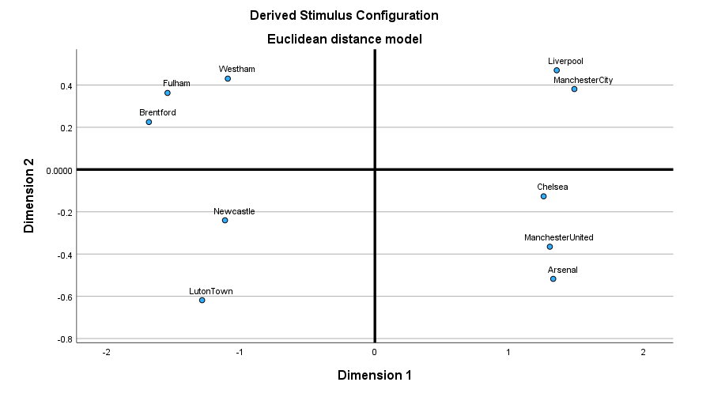

Slide 7
NAMING OF THE AXES
High Spending Clubs
Best Football Academy

Slide 8
THANK YOU

